Slide 1
Home Automation Security System With Artificial Intelligence

Slide 2
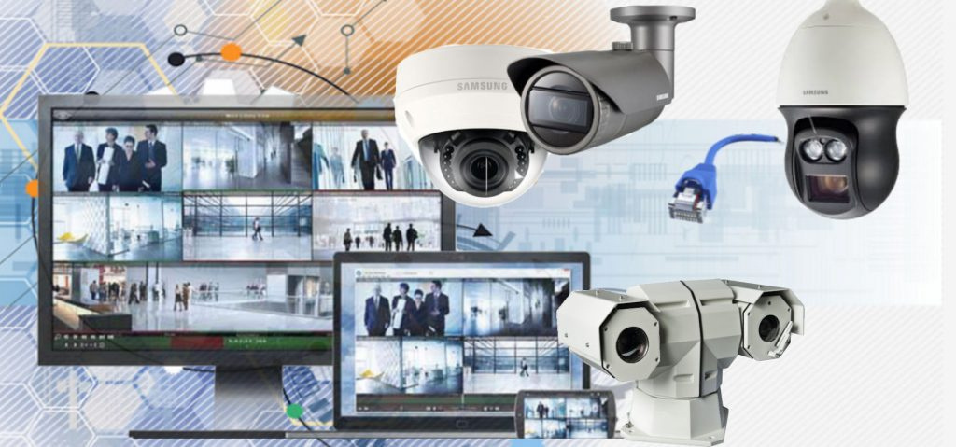
Introduction
Home automation security system with artificial intelligence, monitors who has entered home and uses email alerts.
It secures the home in real time and keeps track of the record.
The camera is used has been connected to the systems .

Slide 3
An image of the unknown person detection is captured by the camera in front of the door.
Homeowner receives an email alert with the image.
Additionally, the owner may also add new faces and data to the databases using an application with Python Tkinter-based GUI.

Slide 4
Objective
With the world moving forward artificial intelligence, internet of things and remote-control consumers want to implement home security with AI,IoT technology and remote access.
To made the home security simple and relatively affordable to monitor the home anytime and anywhere.
To keep the home protected from robbery, secure it in real time, and keeps track of record.

Slide 5

Research Methodology
Build a face recognition system using python with the help of face recognition library.
Detecting faces from Webcam at real time and Show in the form of Picture.
Real Time Face compare with Database save record person face, if both are different , then display a GUI with Real Time Face Detect.
User has two options, Known and Unknown.

Slide 6
When user click known button then display a Form, User fills this form and give the information of Detect Real Time face Person . This information with detect face picture save in the Mongodb database as a record.
Picture, converts them into some numerical encoding like binary form , and stores them with given data record in binary form.
Unknown Person Image send in the form of email with Detect face image

Slide 7
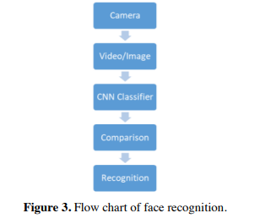

Slide 8

Test
In order to test, we load a picture, encode it, and then compare the encoded data with the encoded data that was saved during training.

Slide 9
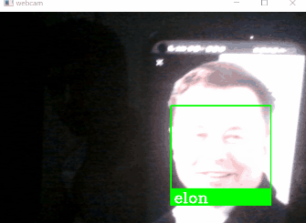
Obtained a name associated with the train encodings when locate the encoding that corresponds to the test image.

Slide 10
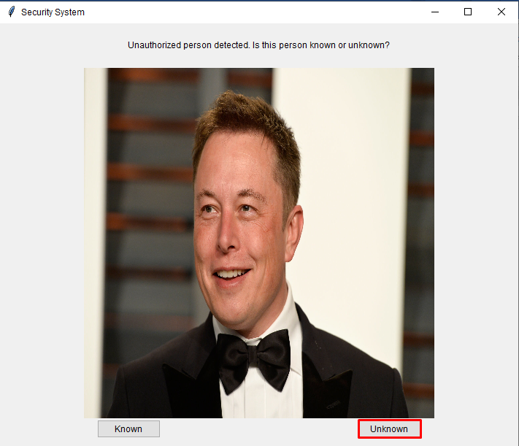
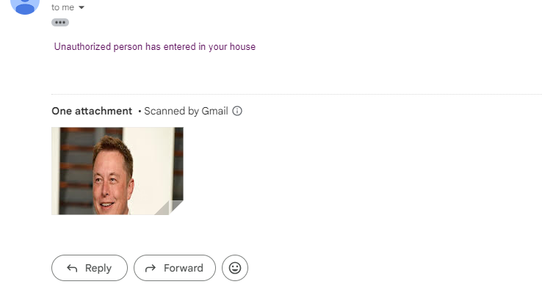
It captures the image of unknown person and send email to the owner.

Slide 11
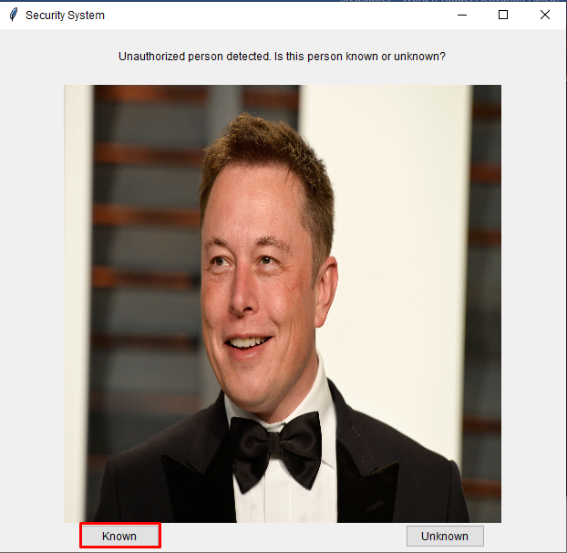
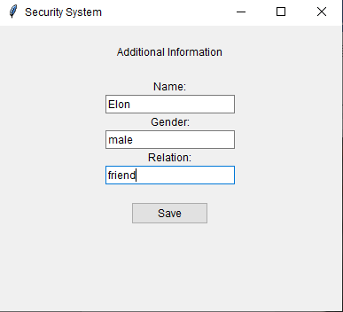
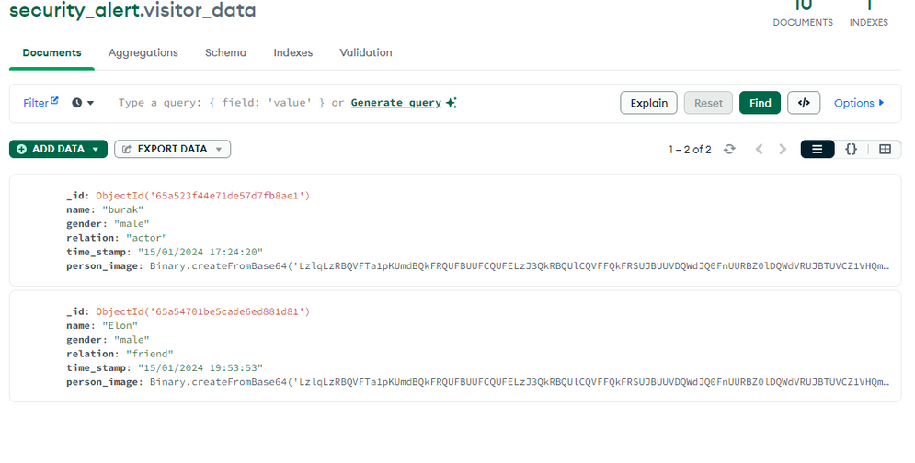
Furthermore, we can enter the records with python Tkinter GUI in monogodb database and Save the Record of Known Person

Slide 12
Conclusion
Home automation security with a face recognition in real-time is designed and developed using artificial intelligence and machine learning approach.
The procedure of the research is developing the face recognition from training the data using machine learning approach by implementing a face recognition library with a single-shot image training technique.
There are few variables that can impact the system's accuracy. In comparison to greater light intensities, accuracy is worse when there is inadequate light. The classifier is the primary component in this recognition process aside from that. The performance of the classifier improves with length of training. To produce a robust classifier, the photos used for training the model need to be under a range of circumstances.

Slide 13
Future Work
In order to prevent fraud and robbery, real-time home security systems may eventually be used in debit cards, merchants, banks, and private businesses.
Additionally, this system may be linked and synced with the database of the nearby police station to track and identify individuals with criminal histories.
Real-time face recognition is using local binary pattern (LBP) with mongodb database which has known persons record.

Slide 14
Any Question

